Slide 1
KASAGA JOHN TRAVOR
2023-B222-10409
QUESTION 3; APRIORI ALGORITHM PRESENTATION

Slide 2
Original transaction list
Transaction_ID | Items
1 | Bread, Milk, Eggs
2 | Bread, Butter
3 | Milk, Diapers, Beer
4 | Bread, Milk, Butter
5 | Milk, Diapers, Bread
6 | Beer, Diapers
7 | Bread, Milk, Eggs, Butter
8 | Eggs, Milk
9 | Bread, Diapers, Beer
10 | Milk, Butter

Slide 3
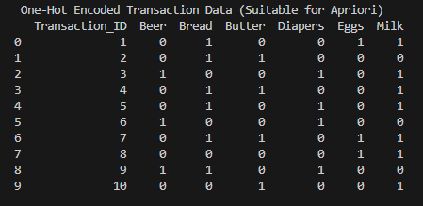
One hot encoded data
Notes:
Categorical data is transformed into numerical data

Slide 4
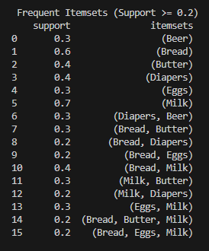
Frequent item set

Slide 5
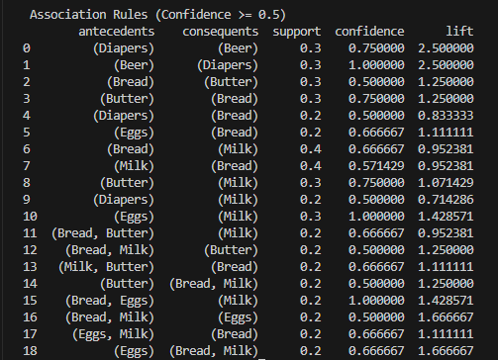
Application of association rules

Slide 6
Best three rules in accordance to lift
Rule 1
Beer →Diapers (lift=2.5); Every customer who buys Beer also buys Diapers 100% confident with beer and diapers strongly associated at a lift of 2.5.
Rule 2
Diapers →Beer(lift=2.5); Every customer who buys Diapers also buys Beer 75% confident with diapers and beer strongly associated at a lift of 2.5.
Rule 3
{Bread, Milk}→Eggs (lift = 1.6667); Every customer who buys Bread and Milk also buy Eggs 75% confident with {Bread, Milk} and Eggs strongly associated at a lift of 1.6667.

Slide 7
Bussiness recommendations.
Product placement; Beer and diapers should be placed near each other in order to increase customers’ convenience hence increasing sales.
Promotional strategy; The supermarket should offer bundle discounts on the sales with a higher lift for example, the one who buys diapers and beer is given a 10% discount of beer.

